Slide 1


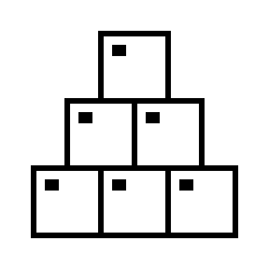







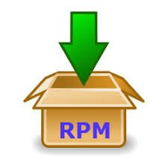

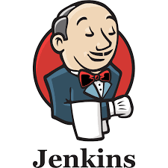




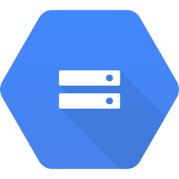
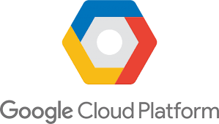






Plan
Development
Build &
Package
Dev
Environment
Cloud Storage
Deploy
Tenant project
QA
Environment
Cloud Storage
Deploy
Dataproc
Composer
UAT
Environment
Test
Cloud Storage
Tenant project
Deploy
Prod
Environment
Dataproc
Composer
Cloud Storage
Release

